Slide 1
CIPD webinar: Working constructively with trade unions
27 January 2023, 12:00 – 13:00

Slide 2
Welcome
Katie Jacobs
Senior Stakeholder Lead, CIPD

Slide 3
Today’s speakers
Rachel Suff
Senior Policy Advisor – Employee Relations,
CIPD
Melanie Simms
Professor of Work and Employment,
Glasgow University
Michael Jude
Human Resource Director,
Nissan
Vince Toman
Senior Employment and Health and Safety Lawyer,
Lewis Silkin

Slide 4
#StrongerWithCIPD
Covid-19 resources
NEW Well-being helpline
Employment Law helpline
Communities and branches
People Management
Knowledge and content
Free learning
Careers support
Professional creditability
Financial support
cipd.co.uk/memberbenefits

Slide 5
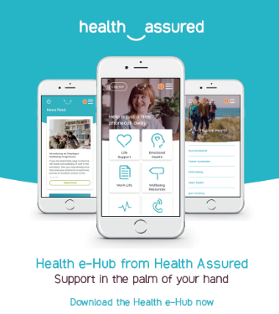
Wellbeing Resources
We’ve partnered with Health Assured to support members mental health and wellbeing
Unlimited free 24/7 confidential telephone helpline, online portal & Health e-Hub app
The resource provides:
Legal information
Debt and financial information
Manager consultancy and support
Information on work and home issues
Factsheets, advice, information and self-help tools
Links to specialist support organisations
A resources area with; programmes, videos, webinars, medical information and mini health checks.
Notes:
In recognition of the increased pressure and personal challenges many of you might currently be facing we’re launched a new Well-being helpline for the UK and Ireland. Calls are FREE and confidential. Phonelines are open 24 hours a day, 7 days a week, 365 days a year.
Work through your problems with a qualified therapist accredited by the British Association for Counselling and Psychotherapy (BACP).
Legal information services - support on a range of issues including personal, financial and legal matters.
Debt and financial information - support for issues such as debt, investments, pensions, managing money, negotiating with creditors.
Manager consultancy and support - at helping people managers to support their teams effectively.
Plus there are online resources and a well-being app you can download.

Slide 6
Rachel Suff
Senior Employee Relations Adviser, CIPD
@RSuff

Slide 7
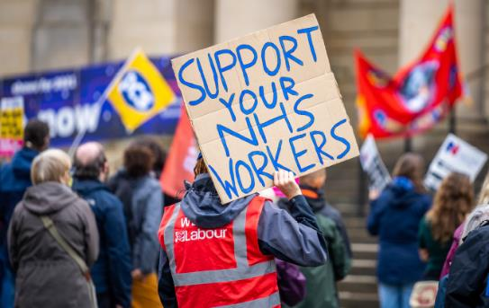
A winter of discontent?
The ‘winter of discontent’ – over 30 million working days lost to strike action in 1979 (162 million in the 1926 General Strike)
November 2022 – 467,000 working days lost (compared with just 234,000 days 2019)
Ongoing wave of industrial action/strikes widely affecting public services in particular, eg transport, postal services, healthcare, education, civil service – even barristers
What are the main causes of the disputes?

Slide 8
Are new laws necessary/helpful?
Government has introduced the Strikes (Minimum Service Levels) Bill in Parliament
Affects six sectors including health, education, transport, fire and rescue services
The Bill has far-reaching implications beyond its stated aim to ensure minimum service levels and the public’s health and safety
Collective negotiation – a more productive approach?

Slide 9
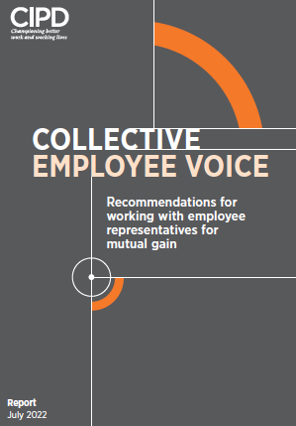
What does this mean for people professionals? – working with trade unions
Trade unions remain a legitimate influence in UK workplaces and an important part of employee voice
CIPD research shows most employers recognise the importance of unions and are open to working together to tackle the big issues – eg 59% agree ‘working in partnership can benefit the organisation’
Employment relations is a key specialism and should be an aspirational career choice for people professionals
We need a partnership approach to managing constructive collective relationships built on honesty and direct communications

Slide 10
Working Constructively with Trade Unions Key legal pitfalls to avoid
27 January 2023
Vince Toman

Slide 11
Collective Bargaining
Wilson v UK held that there is a human rights breach if union members are induced to give up having their terms set by collective bargaining
Section 145B now prohibits an employer from making offers to members of its recognised trade union which, if accepted by all, would mean that their terms will no longer be determined by collective bargaining
The Supreme Court in Kostal rejected Unite’s argument that all terms must always be set by collective bargaining
It also rejected Kostal’s argument that it wasn’t a breach if an offer was only a one-off
Kostal’s mistake was to make offers before exhausting collective bargaining
Exhausting the agreed process set out in the collective agreement is key to avoiding fines of £4,554 per employee
A unilateral pay increase may amount to a breach, although there are conflicting junior appeal court decisions on this

Slide 12
5 key areas of ongoing legal uncertainty
Tesco
The Supreme Court will decide whether an employer may “fire and rehire” to overcome terms stated to be “permanent” in a collective agreement
Deliveroo
The Supreme Court will decide whether riders are “workers” for trade union recognition purposes
Mercer
The Supreme Court will decide whether strikers can bring claims for detriment for industrial action, such as if disciplined or non-contractual benefits are lost
Agency workers
The High Court will decide whether the repeal of the ban on agency workers covering strikers is lawful
Minimum service levels
The Government is proposing new laws to require minimum service levels in key public services

Slide 13
Questions
Please submit your questions for:
Rachel Suff, Senior Policy Advisor – employee relations, CIPD
Melanie Simms, Professor of Work and Employment, Glasgow University
Michael Jude, Human Resources Director, Nissan
Vince Toman, Senior Employment and Health and Safety Lawyer, Lewis Silkin
Please use the Q&A function to submit your questions

Slide 14
#StrongerWithCIPD
Covid-19 resources
NEW Well-being helpline
Employment Law helpline
Communities and branches
People Management
Knowledge and content
Free learning
Careers support
Professional creditability
Financial support
cipd.co.uk/memberbenefits

Slide 15
Wellbeing Resources
We’ve partnered with Health Assured to support members mental health and wellbeing
Unlimited free 24/7 confidential telephone helpline, online portal & Health e-Hub app
The resource provides:
Legal information
Debt and financial information
Manager consultancy and support
Information on work and home issues
Factsheets, advice, information and self-help tools
Links to specialist support organisations
A resources area with; programmes, videos, webinars, medical information and mini health checks.
Notes:
In recognition of the increased pressure and personal challenges many of you might currently be facing we’re launched a new Well-being helpline for the UK and Ireland. Calls are FREE and confidential. Phonelines are open 24 hours a day, 7 days a week, 365 days a year.
Work through your problems with a qualified therapist accredited by the British Association for Counselling and Psychotherapy (BACP).
Legal information services - support on a range of issues including personal, financial and legal matters.
Debt and financial information - support for issues such as debt, investments, pensions, managing money, negotiating with creditors.
Manager consultancy and support - at helping people managers to support their teams effectively.
Plus there are online resources and a well-being app you can download.

